Slide 1
Pizza Delivery System (PDS)
Release 1

Slide 2
Team B: s361-02b
Jedd Haberstro (Configuration/QA Coordinator)
Obaseki Idemudia (Development Coordinator)
Gregg Miller (Team Coordinator)
Johanna Calderon (Requirements Coordinator)
Jenny Zhen (Test Coordinator)
Richard Sperrazza (Development Coordinator)

Slide 3
Features
Creates Customers
Creates Orders
Process Order
View order progress
Send order out for delivery
Manage the Menu
Configure chefs, ovens, and drivers

Slide 4
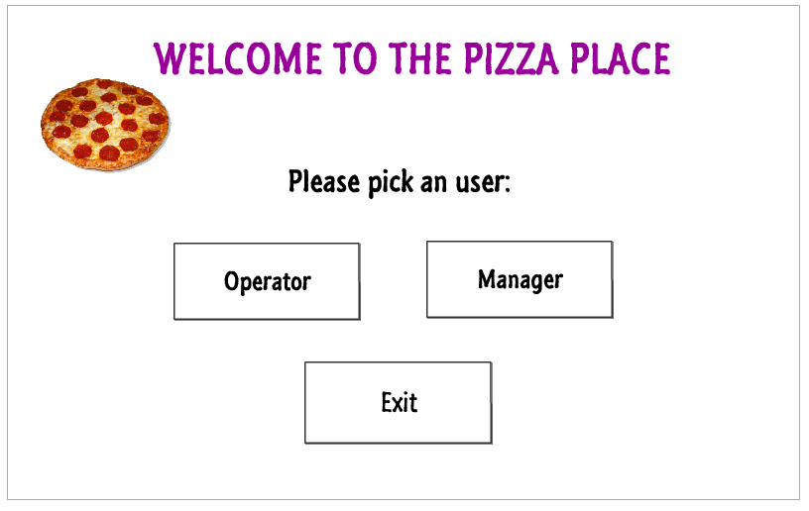
UI Mock-ups

Slide 5
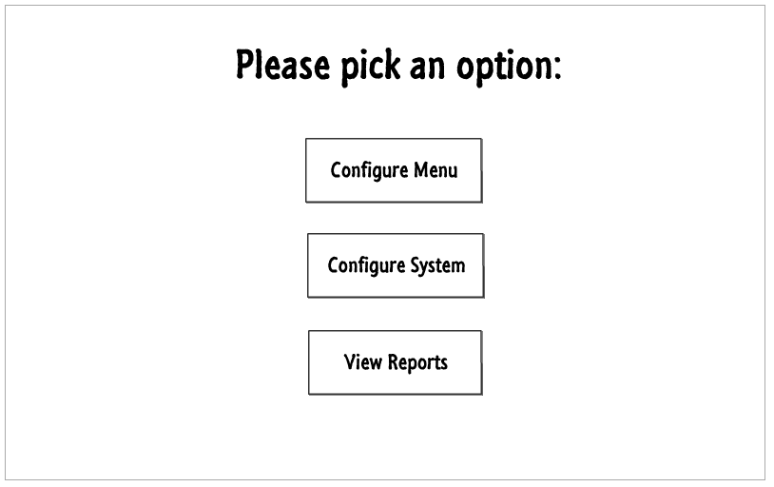
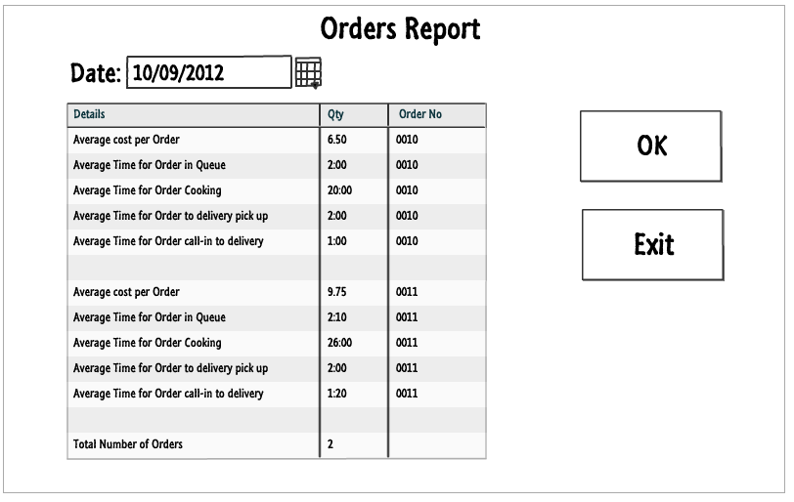
Manager Screens

Slide 6
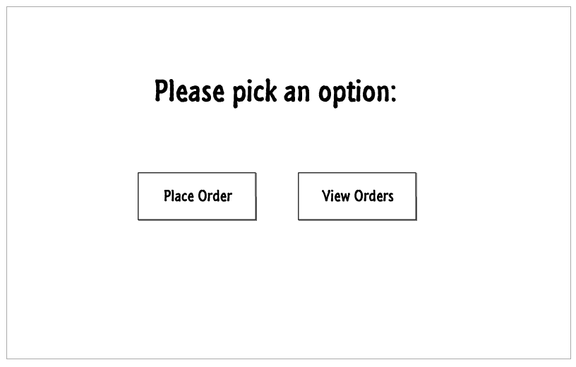
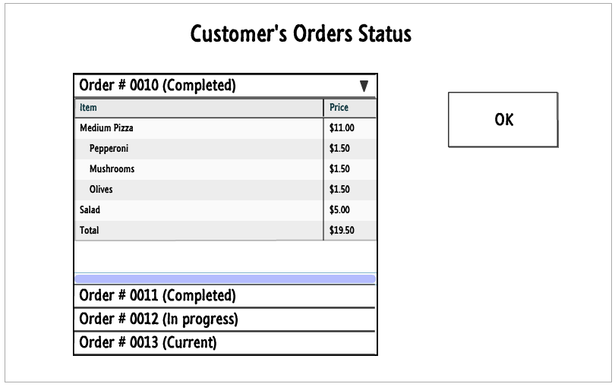
Phone operator screens

Slide 7
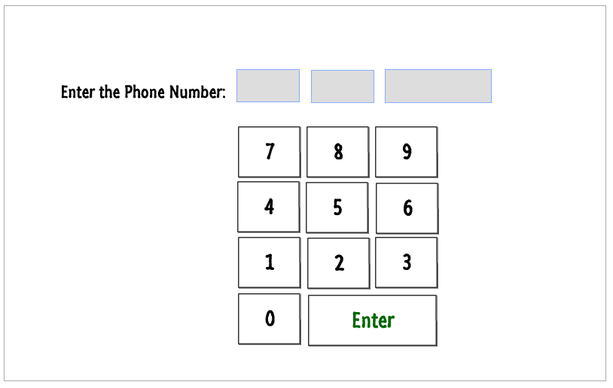
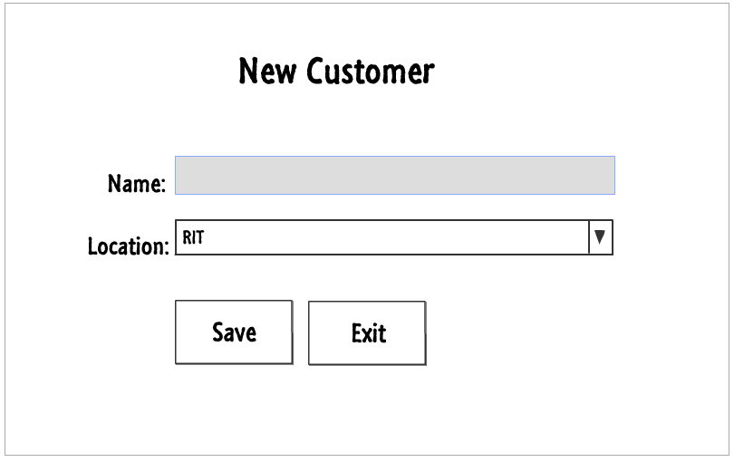
Entry data screens

Slide 8
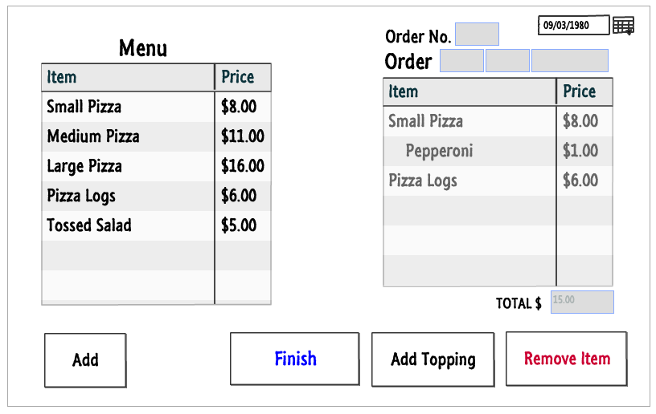
Place Order screen

Slide 9
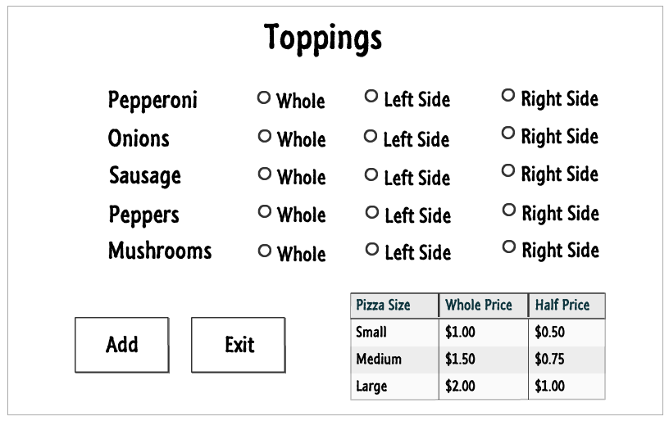
Pop-up screen

Slide 10
Design
Design Plan Document
Testing
Test Plan Document
Demo
Q&A

Slide 11
Thank You !

